Slide 1
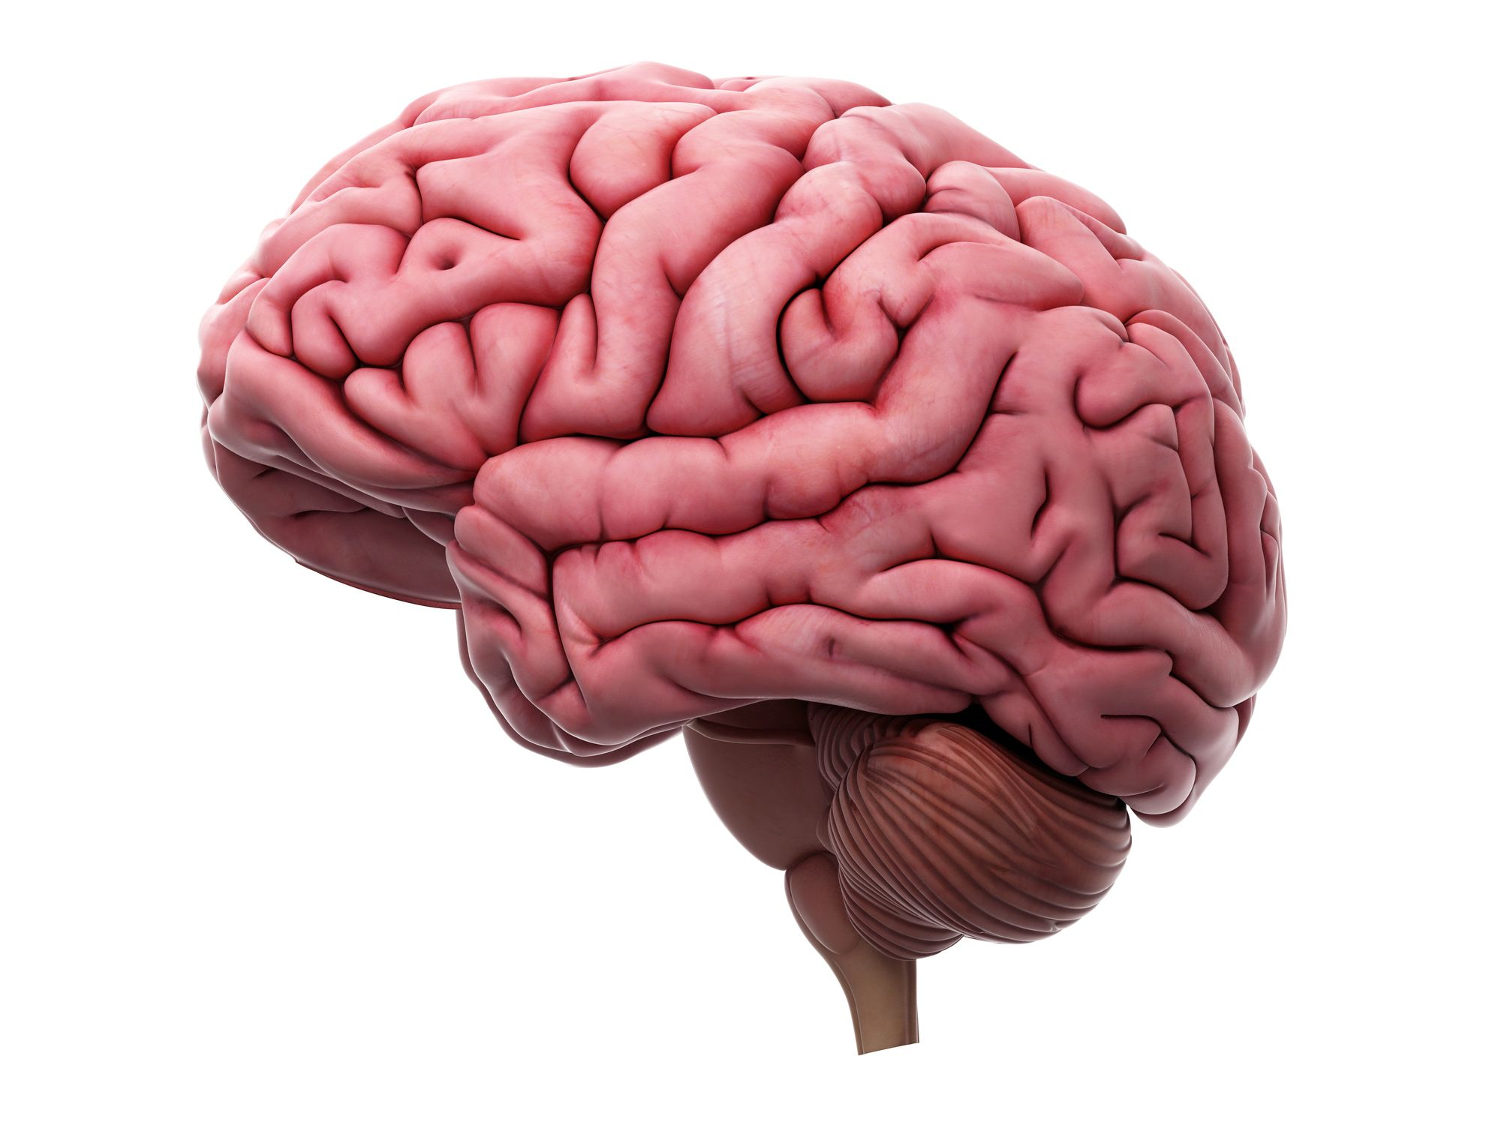

Bapuji Educational Association (Regd.) BAPUJI INSTITUTE OF ENGINEERING AND TECHNOLOGY Department of Computer Science & Engineering Project Phase 2 Presentation - 2020/2021 ON
BRAIN TUMOR DETECTION USING DEEP NEURAL NETWORK
Presented By :
MEGHANA G
4BD17CS063
NEHA U K
4BD17CS075
ROJA DEVINA
4BD17CS094
TEJASWINI
4BD17CS113
Under the guidance of:
Prof. Gangadharappa S M.Tech.
Project Co-ordinator:
Dr. Roopa G M Ph.D.
HOD:
Dr. Nirmala C R Ph.D.

Slide 2

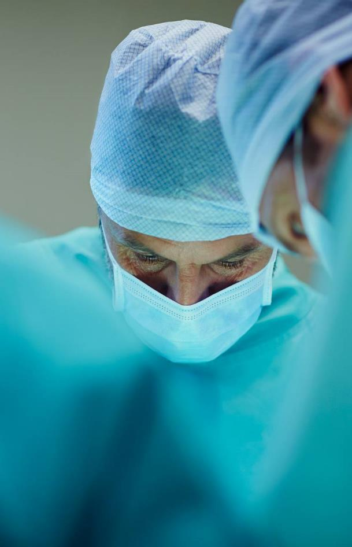
Agenda
Abstract
Introduction
Literature Survey
Motivation
Deep Learning
CNN
Dataset Description
Existing Problem
Proposed Solution
Objectives
Methodology
Work Flow
Experimental Investigation
Demonstration
Results
Conclusion

Slide 3
Abstract
In recent decades, brain tumor detection has become one in every of the foremost difficult issue in medical science. Early detection of those tumors is highly required to supply treatment for patients. In this project we present a machine learning approach to detect whether an MRI image of a brain contains a tumor or not if yes which type of tumor. In the present environment various classifying algorithm are available to classify the brain tumor images. According to observations made for detection of tumor, it is observed that the Decision Tree (DT) classifier gives 94.24% accuracy because of the lag in accuracy we considered implementing Convolutional Neural Network (CNN) to classify and detect tumor presence in the brain through Magnetic Resonance Imaging (MRI) images. In addition to the accuracy criterion, we use the benchmarks of Sensitivity, Specificity and Precision to evaluate CNN performance. This is a new method based on the combination of feature extraction techniques with the CNN for tumor detection from MRI images. CNN improves accuracy which is the important for diagnosing the tumor, the accuracy predicted by the model helps the doctors in diagnosing the tumor and treating the patient at earlier stages.

Slide 4
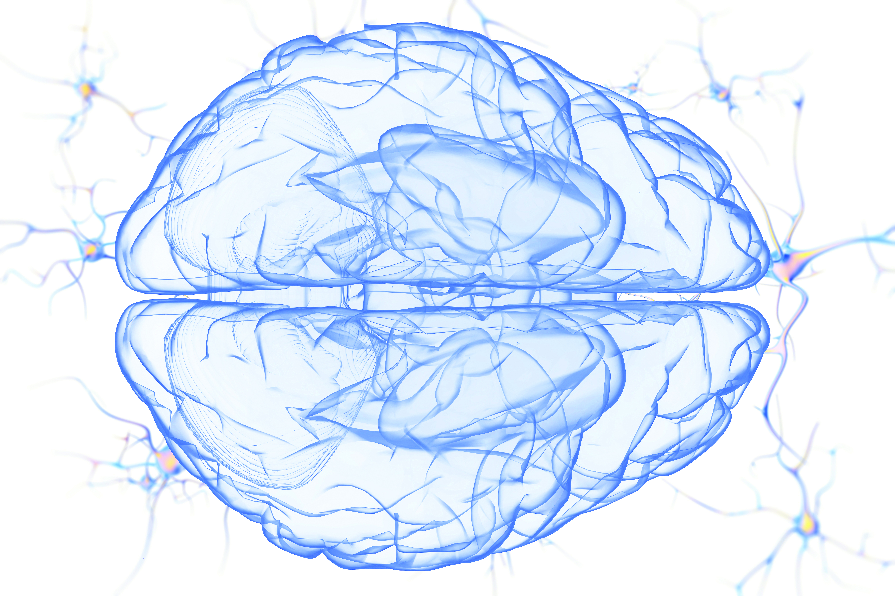
INTRODUCTION
A tumor may be a mass of tissue that is fashioned by accumulation of abnormal cells. Normally, the cells within the body die, and are replaced by new cells counting on the age, but the cancer cells keep on multiplying.
The tumor may be found in any a part of the organic structure like, Lungs, Breast, Stomach, Liver, Uterus, Brain. In this project we have a tendency to primarily concentrate on tumor in Brain.
When tumor spread in any part of brain then it is known as brain tumor. Now when brain tumor can identified number of symptoms including seizures, mood changing, difficulty in walking and hearing, vision, and muscular movement etc. Some types of tumor like neoplasm, Glioma, and Pituitary tumors measure a lot of common Meningiomas measure the foremost common form of tumors that originate within the skinny membranes that surround the brain and funiculus.
Why this problem occurs? It occurs due to inaccurate location of area of tumor. The next step is to detect the tumor. There are various way to detect the tumor some are 1) MRI scanning that is magnetic resonant image
2) CT scanning i.e. computer tomography
3) Ultra sound etc.
Most expert radiologist recommend MRI for detection a brain tumor as it is more effective and accurate regarding shape, size and location of brain tumor.

Slide 5
Literature survey
SL.NO | AUTHOR | TITLE | METHODLOGY | REMARKS
1. | Mohammad Teshnelab et al., 2019 | Proposed a research on Brain Tumor Detection Using Deep Neural Network and Machine Learning Algorithm. | This method is based on the feature extraction techniques with the CNN, where MRI Images first applied to the CNN. | The accuracy of Softmax Fully Connected layer used to classify images obtained 98.67%. Also, the accuracy of the CNN is obtained with the Radial Basis Function (RBF) classifier 97.34% and the Decision Tree (DT) classifier, is 94.24%.
2. | Halimesh Siar et al.,2019 | They proposed a research on Diagnosing and Classification Tumors and MS Simultaneously of MRI using CNN. | They proposed CNN for automatic extraction of the feature and high classification power. | Used CNN to detect the simultaneous diagnosis of tumor and MS with an accuracy of 96%.
3. | F Samadi et al., 2018 | Proposed a research on Change detection in SAR images using deep belief network a new training approach based on morphological images. | This method provided a dataset with an appropriate data volume and diversity for training the DBN using input images and the images obtained from applying the morphological operators on them. | Experimental result indicated that the proposed method had an acceptable implementation time in addition to its desirable performance and accuracy.
4. | Digvijay Reddy et al., 2017 | Proposed a research on Brain Tumor Detection Using Image Segmentation Techniques. | Pre-processing technique is used to remove noise from image. To this image, k-means clustering is applied and from this clustered image, skull was removed using morphological operations to identify tumor cells easily. | Performance matrices like True positive(TP),TN,FP,FN precision and recall to measure the accuracy of the result is evalvated.
5. | Animesh Hazra et al., 2017 | They Proposed a research on Implemented Brain tumor detection based on segmentation using MATLAB. | The proposed methodology consists of three stages i.e. pre-processing, edge detection and segmentation. | The image is clustered using the k-means algorithm. Here they used MATLAB for the development of the project.

Slide 6
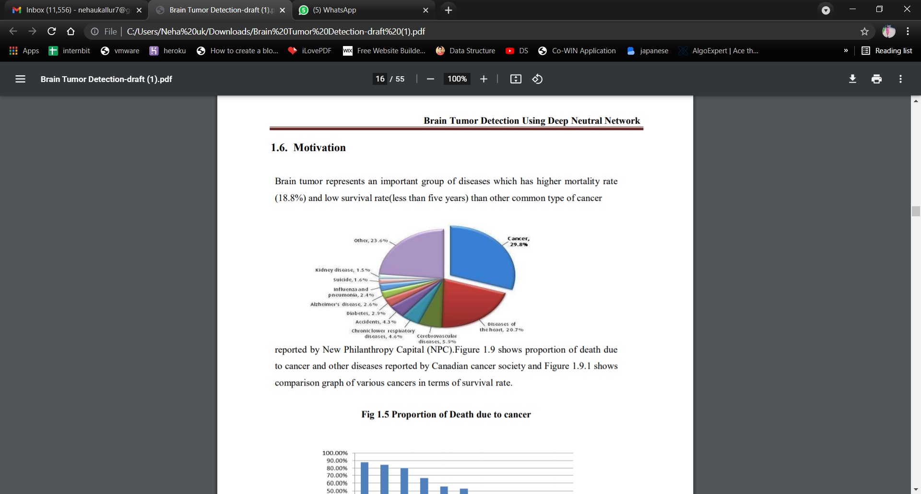
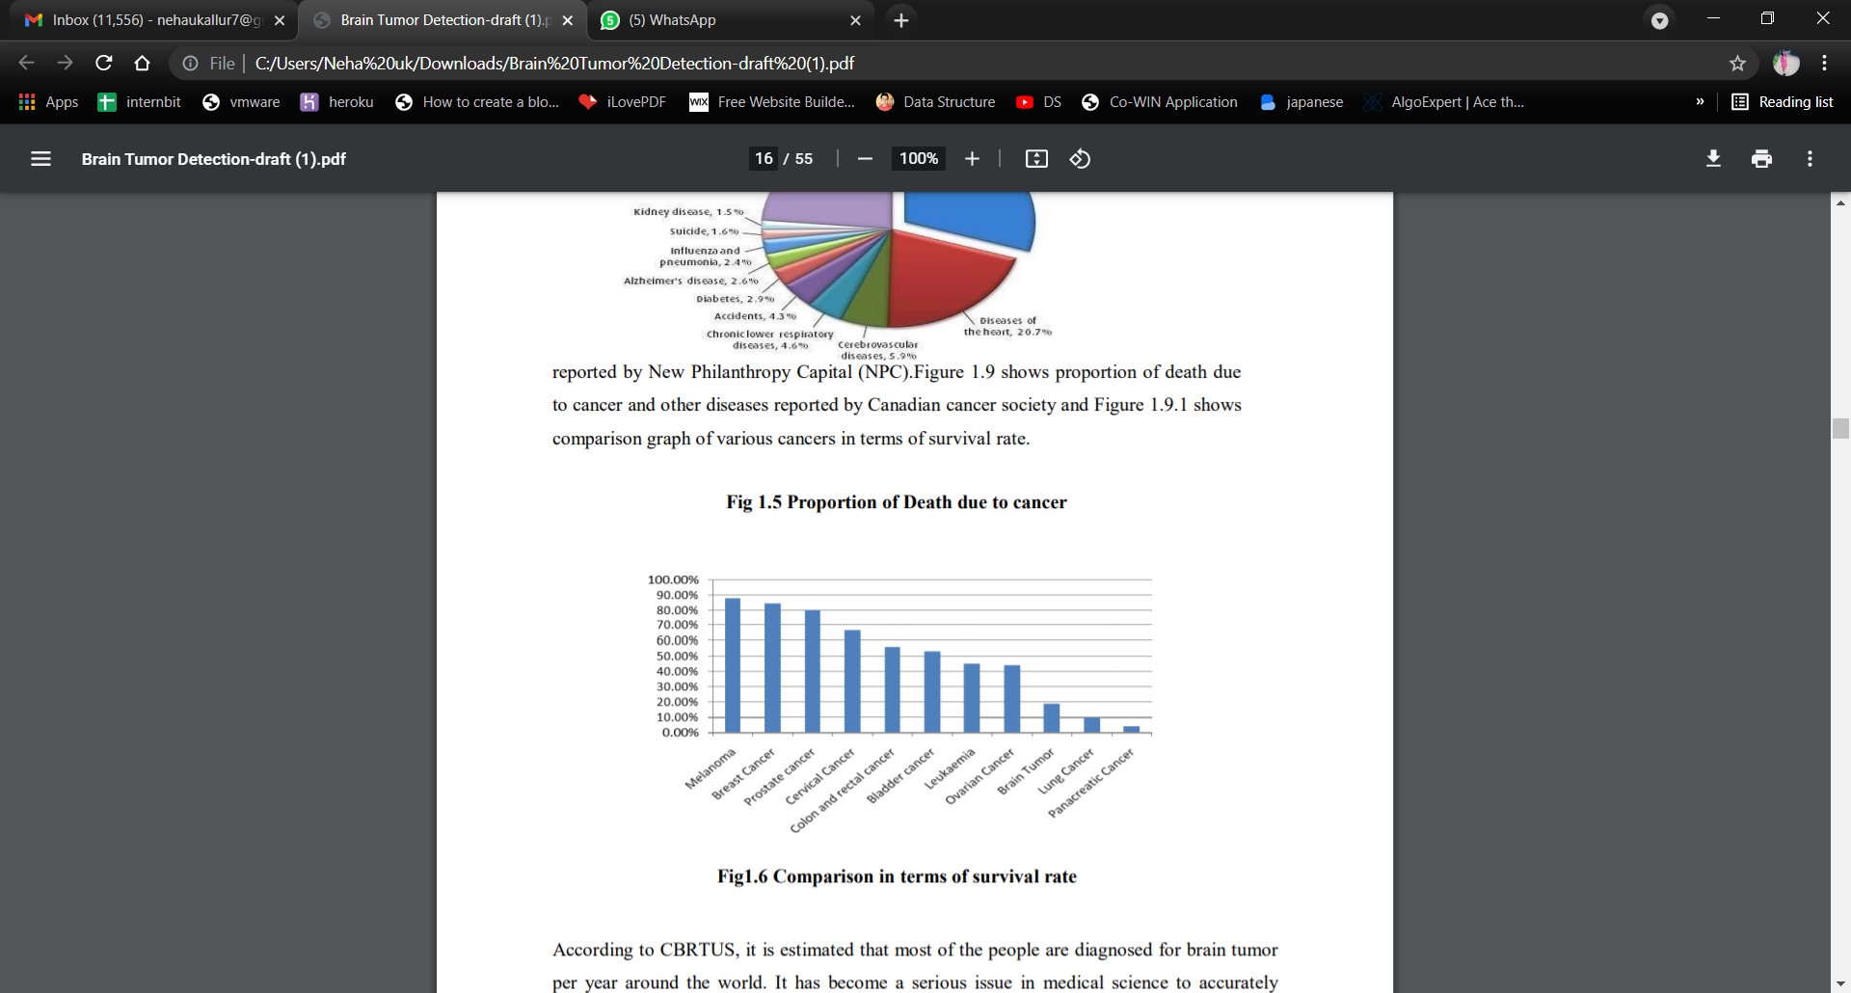
motivation
Brain tumor represents an important group of diseases which has higher mortality rate (18.8%) and low survival rate(less than five years) than other common type of cancer reported by New Philanthropy Capital (NPC).
Figure shows proportion of death due to cancer and other diseases reported by Canadian cancer society and
Figure shows comparison graph of various cancers in terms of survival rate.

Slide 7

According to CBRTUS, it is estimated that most of the people are diagnosed for brain tumor per year around the world. It has become a serious issue in medical science to accurately detect brain tumor since it deals with human life. For this reason, Medical, Mathematical, Computer science researchers have combined their knowledge and efforts to better diagnose the disease for effective treatment. Main motivation for this project work can be summarized as follows.
As to minimize human errors as it can possibly help physicians and radiologists with some segmenting software that will produce more accurate and fast results. Error minimization is necessary because it must deal with human lives.
In these days, CAD (Computer Aided Diagnosis) software‘s are being used by radiologists for early detection so that treatment can start earlier. CAD helps medical expert in making final decision by providing second opinion.
Automatic segmentation also encourages new application to be developed e.g. Content Based Image Retrieval (CBIR). In large medical databases, it is very easy to find out particular record for knowing medical history of patient and patient‘s family. Also, same type of tumor if treated by a doctor then previous record can help this time

Slide 8
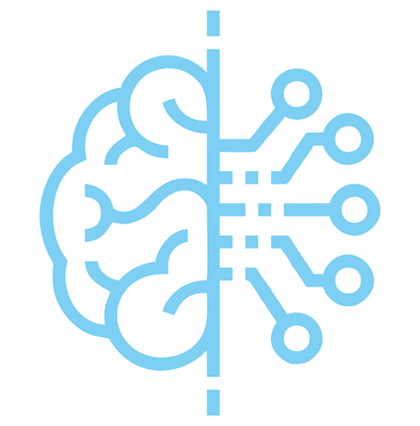

DEEP LEARNING
Deep learning is a type of machine learning and artificial intelligence that imitates the way humans gain certain types of knowledge. Deep learning is an important element of data science, which includes statistics and predictive modeling

Slide 9
CONVOLUTION NEURAL
NETWORK(CNN)
Convolutional neural network (CNN, or ConvNet) is a class of deep neural networks, most commonly applied to analyzing visual imagery. The pre-processing required in a ConvNet is much lower as compared to other classification algorithms. While in primitive methods filters are hand-engineered, with enough training, ConvNets have the ability to learn these filters/characteristics. In our project we trained our model using CNN algorithm. The MRI images are preprocessed and feature extraction of the image is done after the extraction the images are classified accordingly.

Slide 10
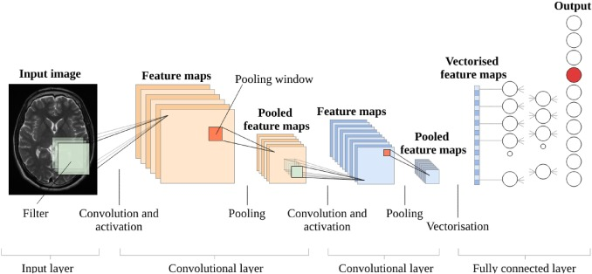
Implementation using cnn
Classified Image
Glioma
Meningioma
Pituitary
No-tumor

Slide 11
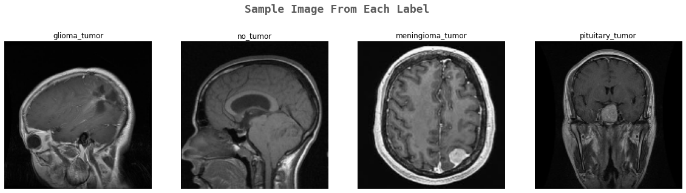
DATASET DESCRIPTION
We collected the images from Kaggle, and created the Dataset containing two folders: train set and test set.
In these sets, we have four categories:
Glioma
No_Tumor
Meningioma
Pituitary.
total images collected are 3500 of all the above mentioned categories and the images are split into test and train before pre-processing
Glioma is a type of tumor that occurs in the brain and spinal cord.
Meningioma is the most common type of primary brain tumor, originate in the meninges, which are the outer three layers of tissue between the skull and the brain that cover and protect the brain just under the skull.
Pituitary tumor are found in the pituitary gland near the brain that can cause changes in hormone levels in the body.

Slide 12

EXISTING PROBLEM
Brain tumor at early stage detection is extremely tough task for doctors to identify, imaging pictures are additional liable to noise and alternative environmental interference. The manual identification of tumor from imaging pictures might vary from knowledgeable doctors looking on their experience, due to lack of specific and correct quantitative measures to classify the imaging pictures. So this method would lead to varying results of detection and would cause conflicts, and it becomes necessary to come up with ideal methodology to cope up with the problem.

Slide 13

PROPOSED SOLUTION
By considering the existing problem we tend to come up with an automatic model to detect the brain tumor patients through MR images. CNN is utilized for figuring out how to area pictures. CNN extracts straightforwardly from pictures with least preprocessing. It's a lightweight profound neural spec intended for playing semantic division, during this technique we tend to apply image preprocessing to observe tumor and various of image filtering techniques for accuracy. The first half we train the model with a number of the brain tumor pictures till we obtain a good accuracy. Based on the extracted options the model detects the tumor from pictures and predicts the presence of tumor or not if yes which type of tumor. Later on we tend to create a UI to for prediction and also to keep a track of patients and doctor details using DataBase(SQLite)

Slide 14
objectives
To preprocesses the given MR image to enhance the image.
To extract the features for identifying the tumor from the MR images .
To classify the image using CNN classifier algorithm to detect the tumor and non tumor. And to specify the
type of the tumor.

Slide 15
Requirements specification
Software:
Programming Language: Python (Version: Python 3.6.8 )
IDE: Jupyter ,Spyder
Operating System: Windows 10
Frame Work : Flask
DataBase : SQLite
Hardware:
Processor: i5
RAM: 4 GB
Hard Disk: 128 GB

Slide 16
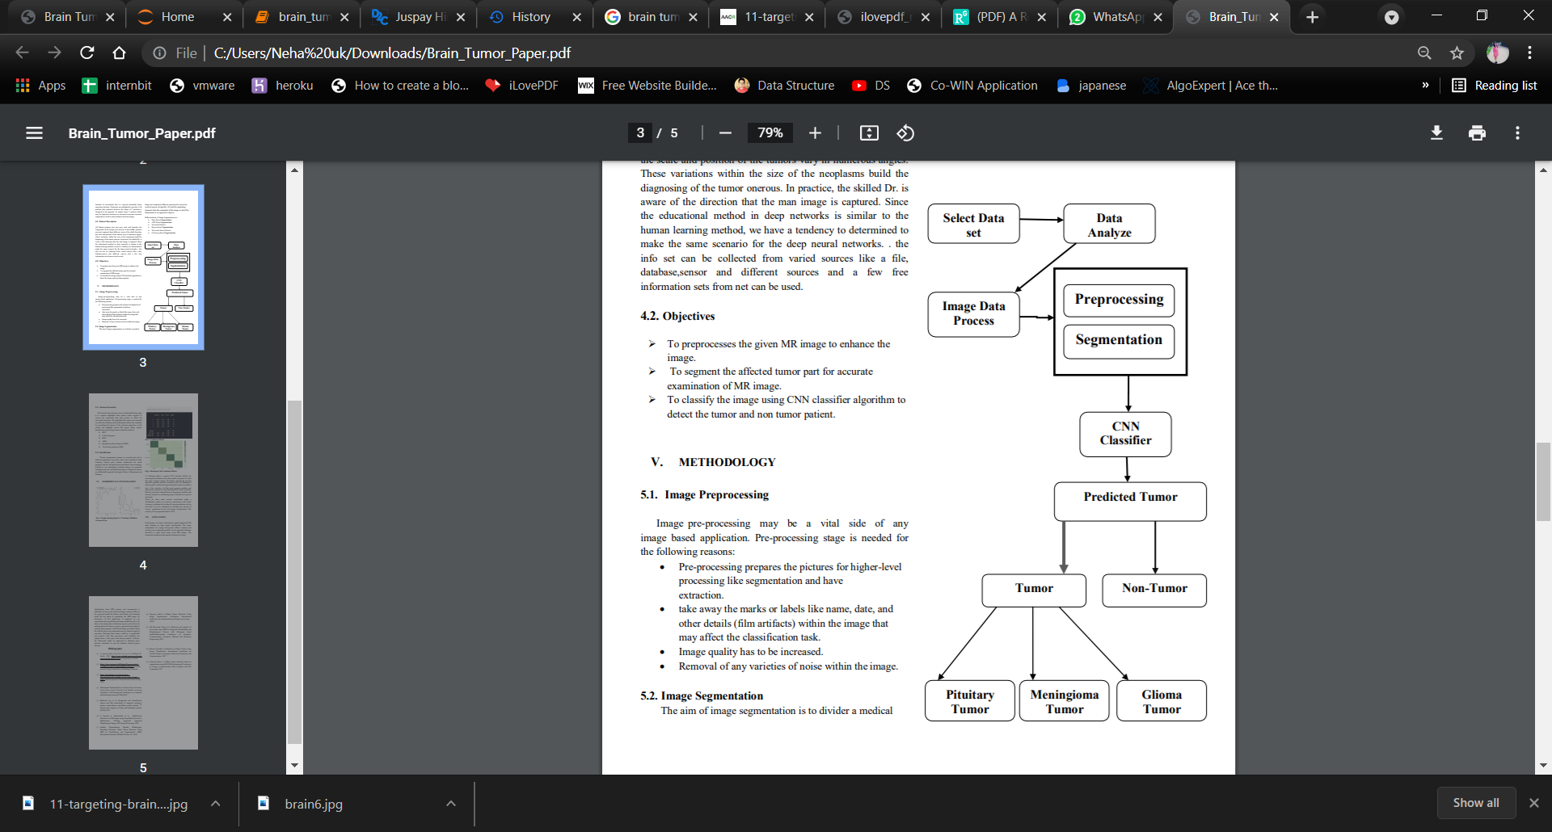
Methodology
BLOCK DIAGRAM
1. Image Preprocessing
Image Preprocessing is used to improve the image data that suppress undesired distortions or enhances some image features important for further processing.
Pre-processing
2. Feature Extraction
Feature Extraction is used for constructing combinations of the variables to get around these problems while still describing the data with sufficient accuracy.
3. Classification
Classification is used to separate the dangerous tumor into types Glioma, Meningioma and Pituitary.

Slide 17
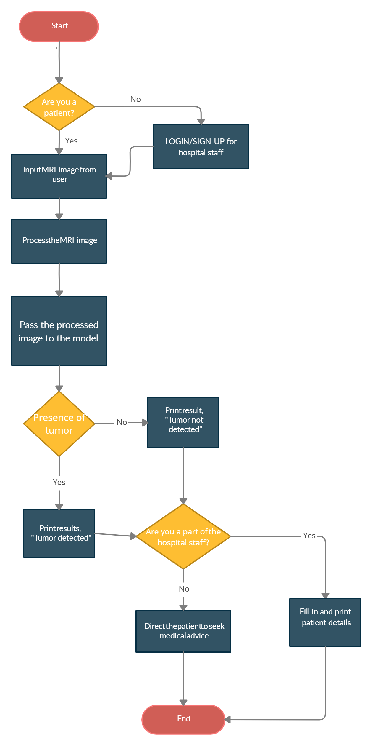
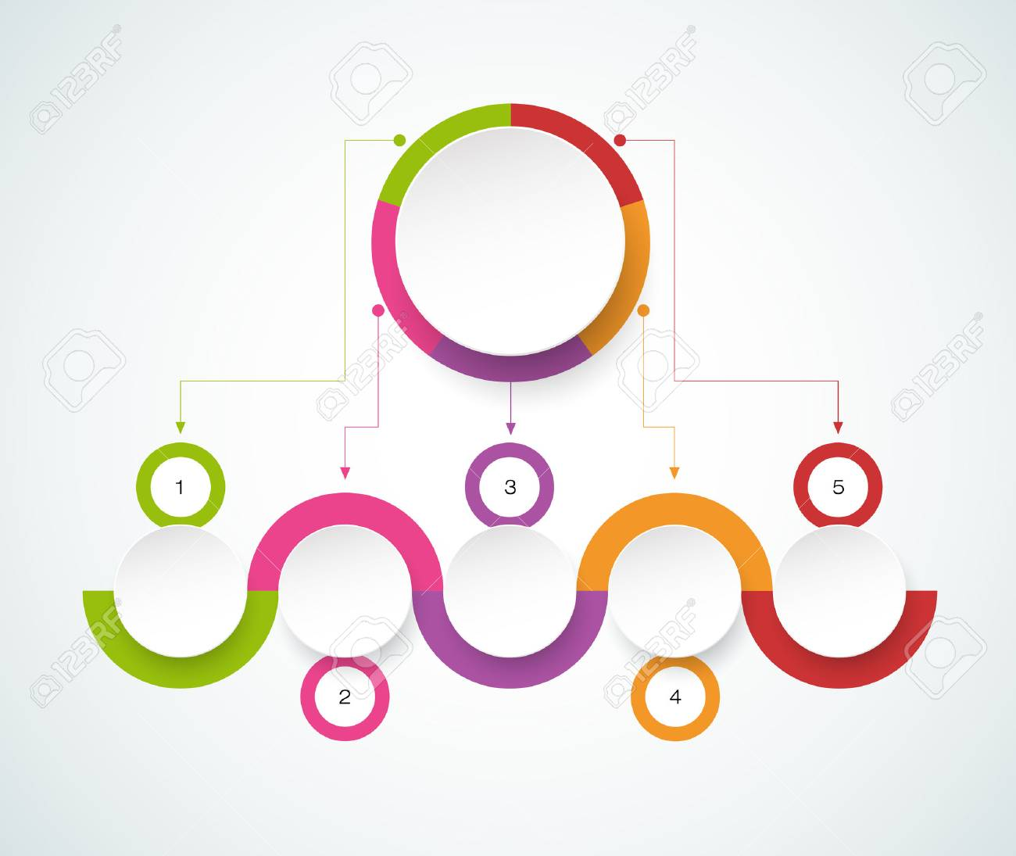
Workflow

Slide 18


Slide 19
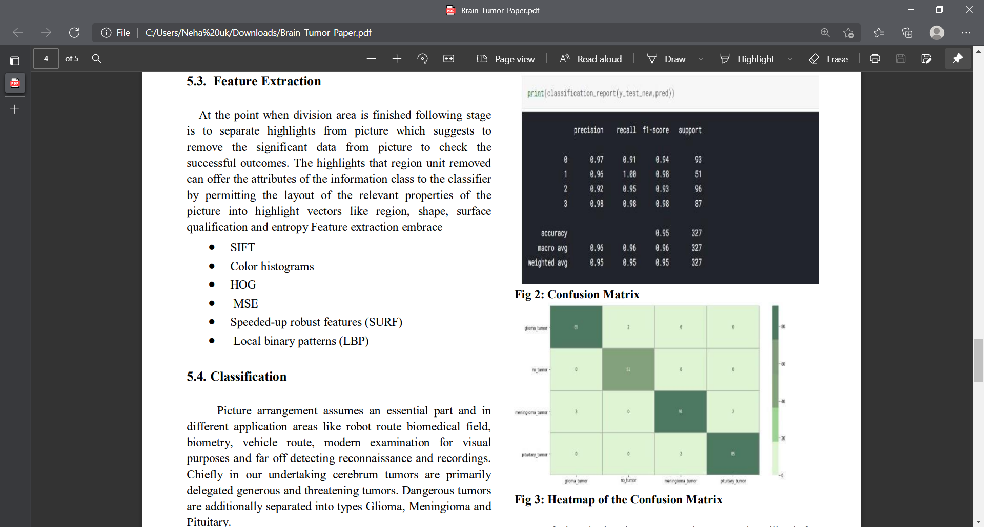
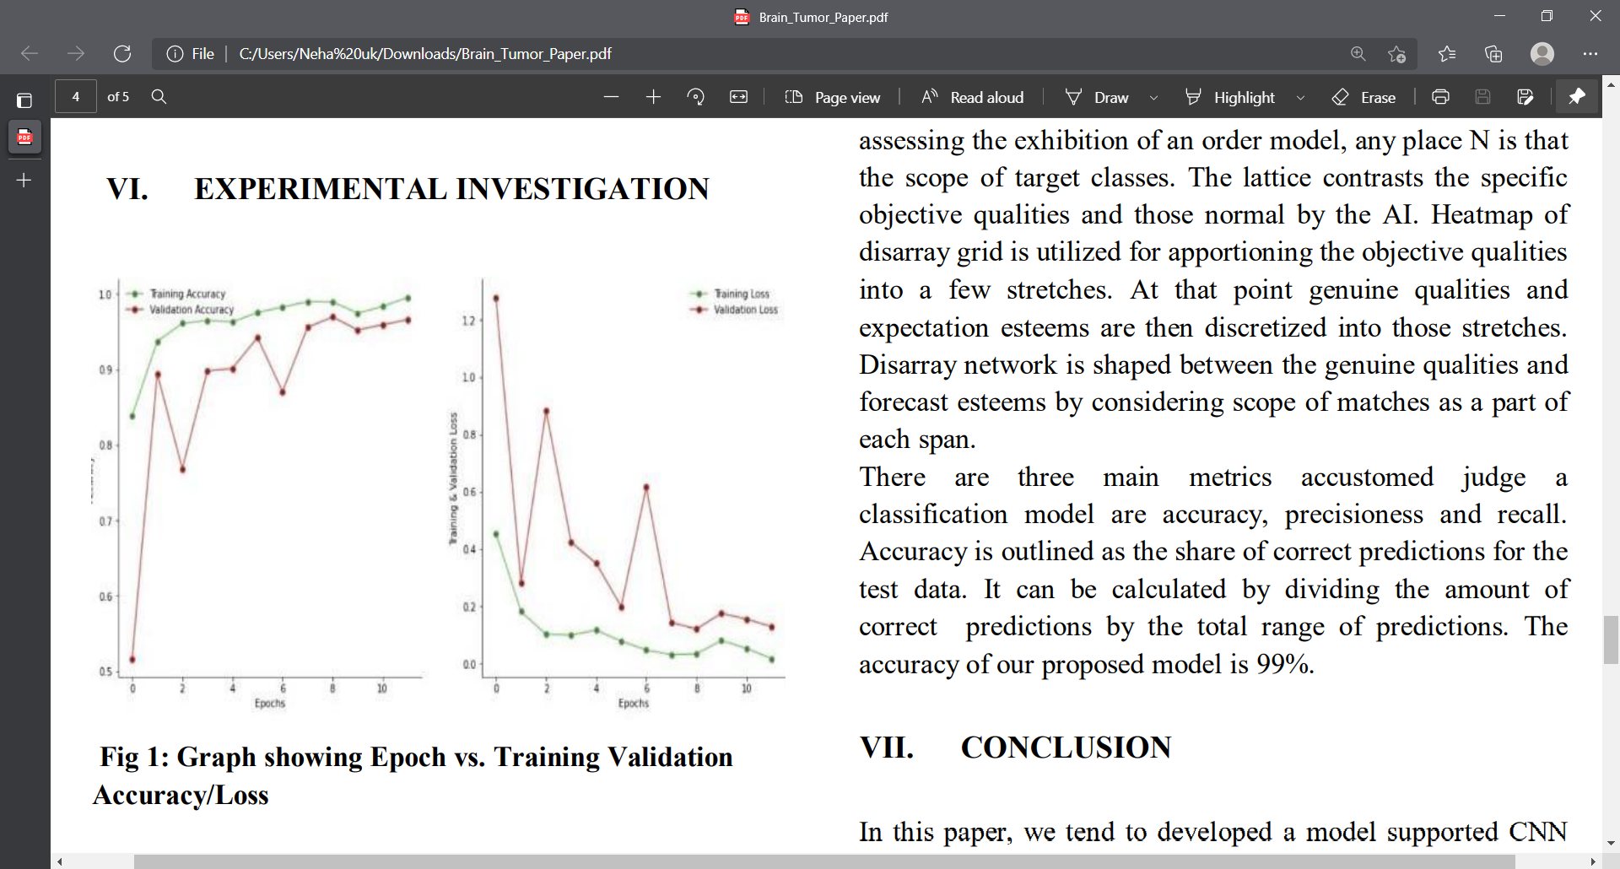
Experimental investigation

Slide 20
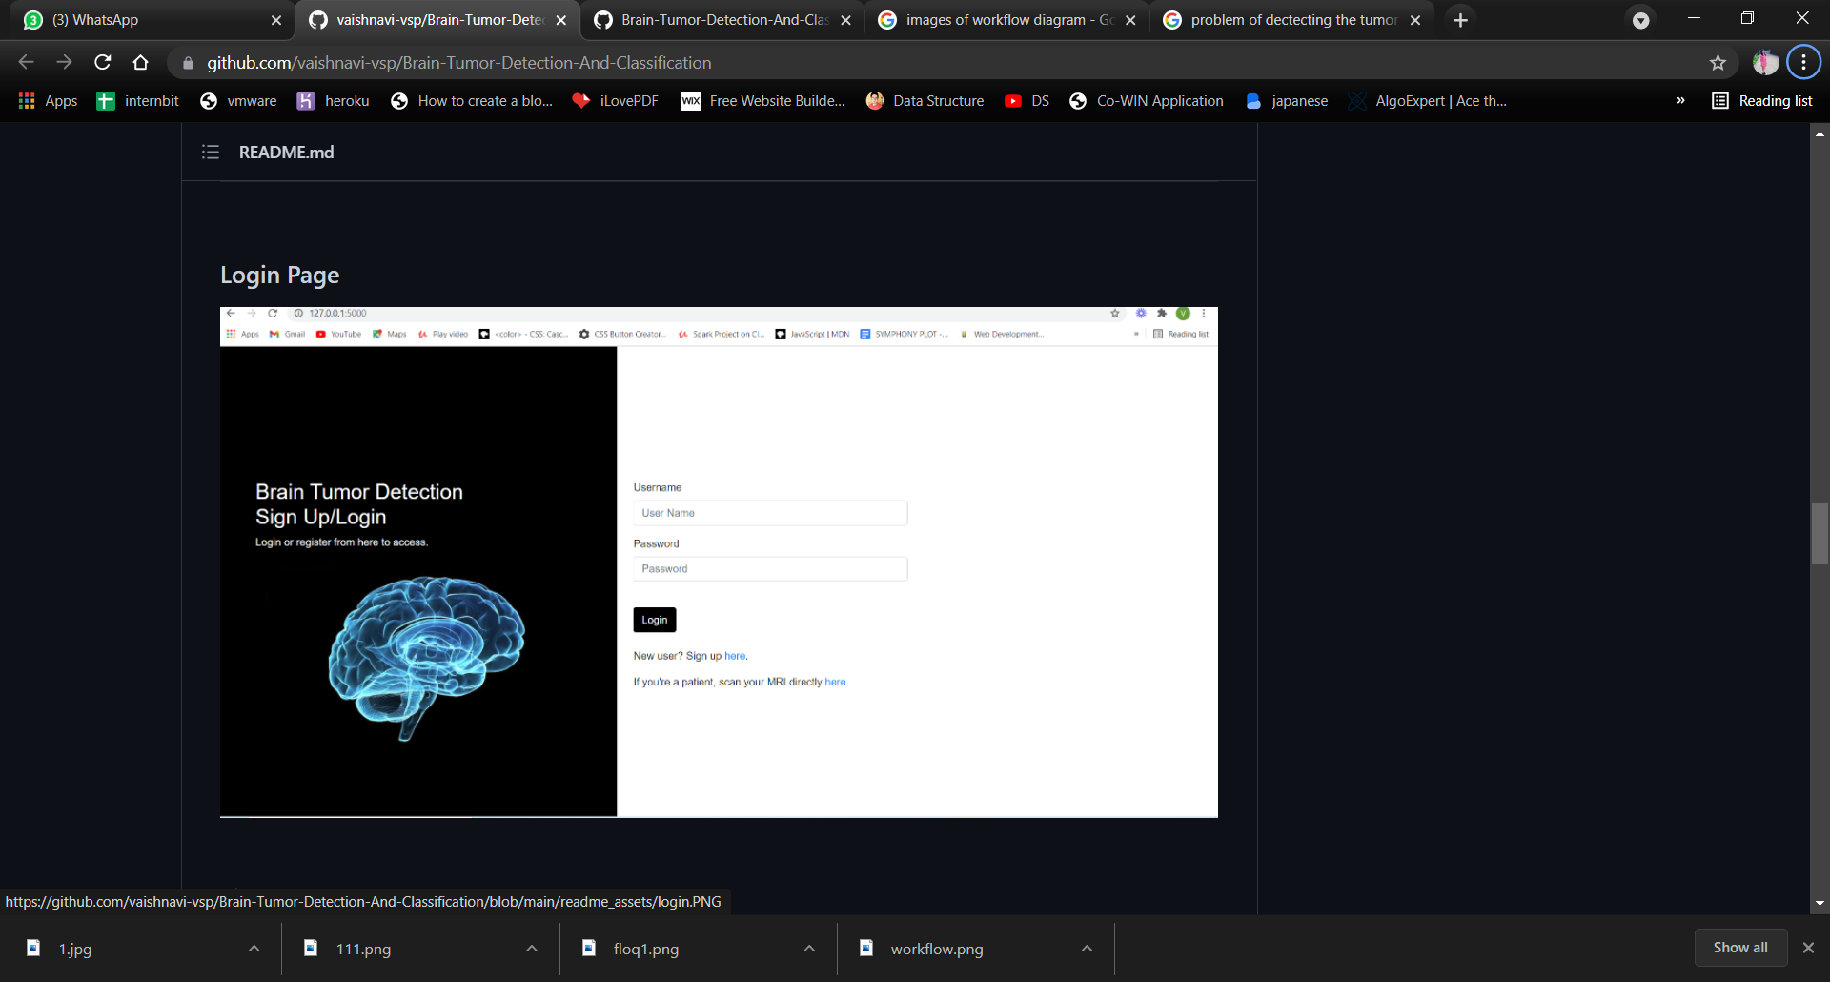
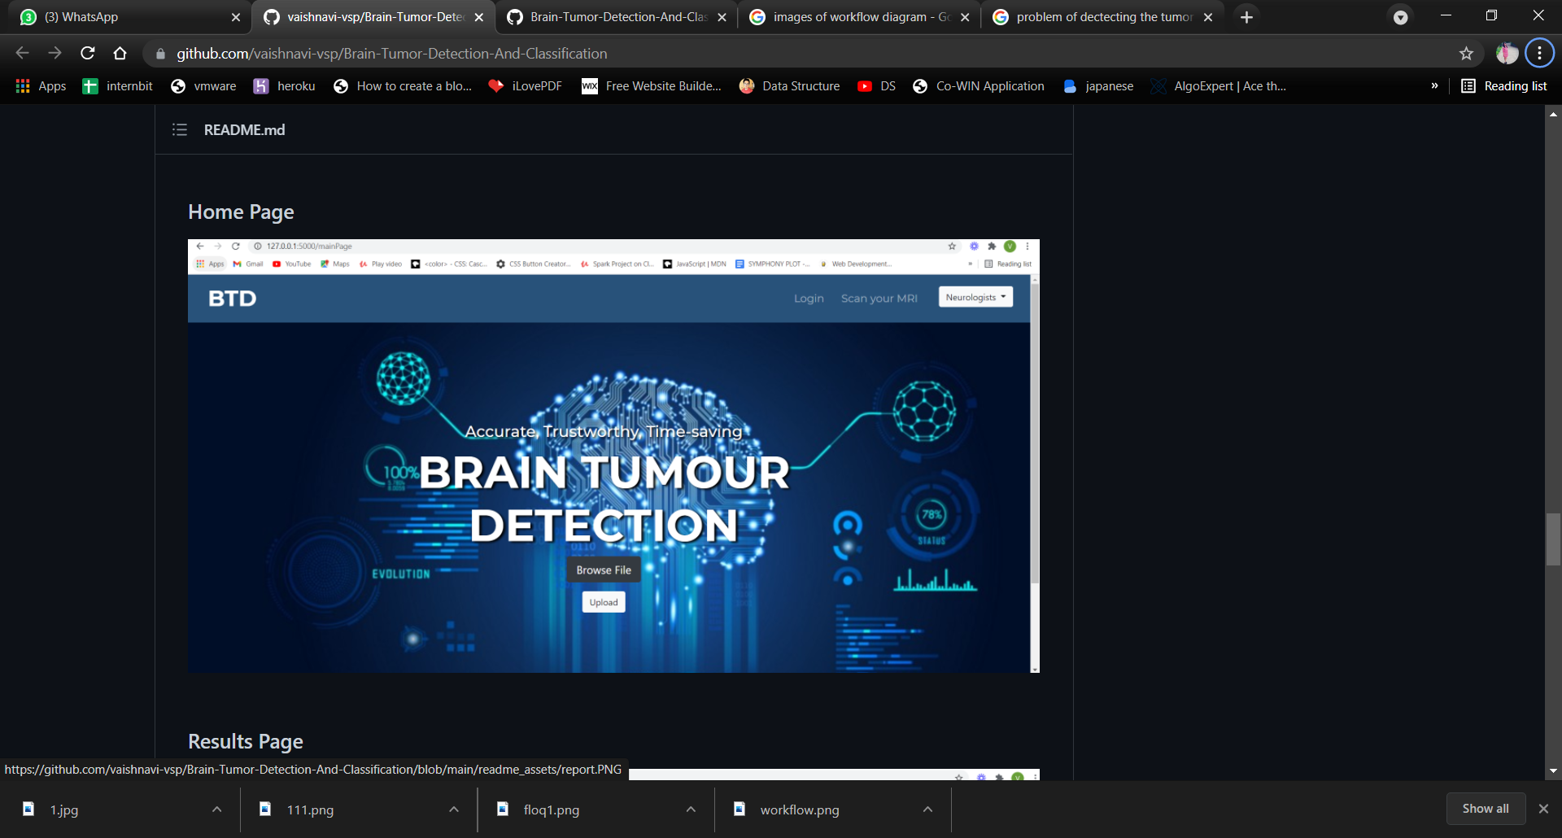
Results
Login page for the Doctors to keep a track
of all the details in the database for future use
Home page where the MRI images are browsed and
uploaded

Slide 21
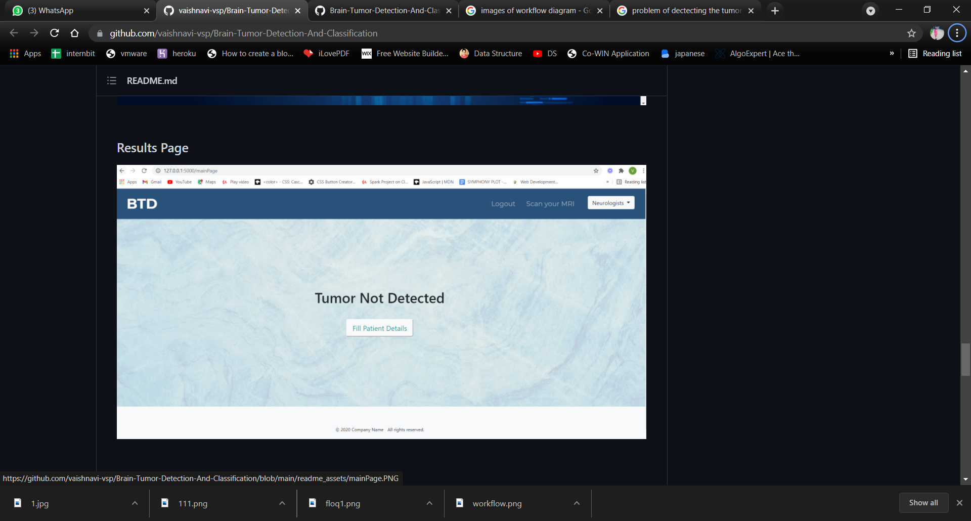



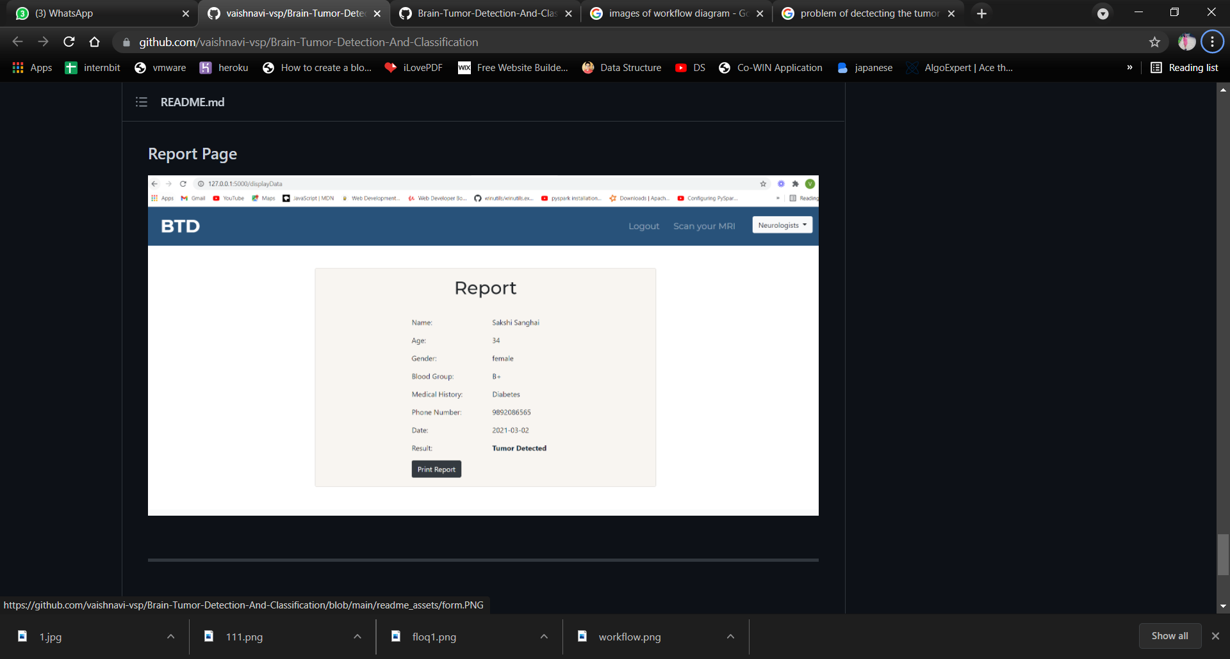
Result page where the presence Glioma ,
Meningioma ,Pituitary and no tumor are showed
Neurologists page for the further appointments
Details of the patients with to be filled
Report of the patient for the further reference

Slide 22




conclusion
Here in the projected model the Doctor and Patient will manually check for the tumor by uploading the MRI image by themselves. If this application is employed by any organization then registration and login method has to be done so the information of detection may be noted. Once the model predicts the tumor a report is generated and might be used for future purpose. All the knowledge are deployed within the SQLite Database so any information may be fetched if necessary. Detecting brain tumors could be a complicated and sensitive task, thus preciseness and reliability can equally show a vital a part of the chosen method. In future, the framework might be improved by adjusting more division calculation to suit the different clinical picture division.

Slide 23

Paper Published at 7th National Conference
on
Advancements in information technology
NCAIT 2021
Paper Title: “ Brain Tumor Detection using Deep Neural Network”

Slide 24



